Slide 1
ISE-529 Predictive Analytics
Module 3: Linear Regression, Part 1 Model Definition and Assessment
Primary text: ISLR, Chapter 3

Slide 2
Linear Modeling Overview
Next Six Modules
Linear regression model definition and fitting: Module 3
Linear regression model assessment statistics: Module 3
Linear model diagnosis: Module 4
Linear model validation: Module 4
Model selection and regularization (deciding which predictors to include in a model): Module 5
Moving beyond linearity (incorporating nonlinearities into the linear model structure): Module 6
Extension of linear models to classification response variables: Module 7
Generalization of linear models to other types of response variables: Module 8

Slide 3
Outline
Model specification and assessment
Model specification and fitting
Linear model inference
Model assessment
Overall fit statistics
Introduction to Scikit-Learn
Assessing accuracy of coefficient estimates
Assessing model accuracy
Model extensions
Incorporating categorical predictors
Adding nonlinear variables
Adding interaction effects

Slide 4
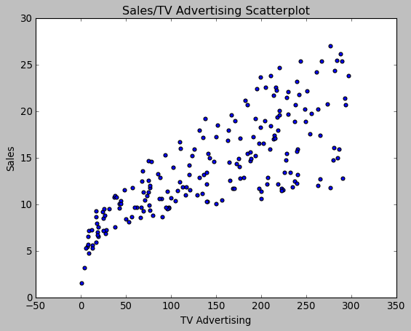
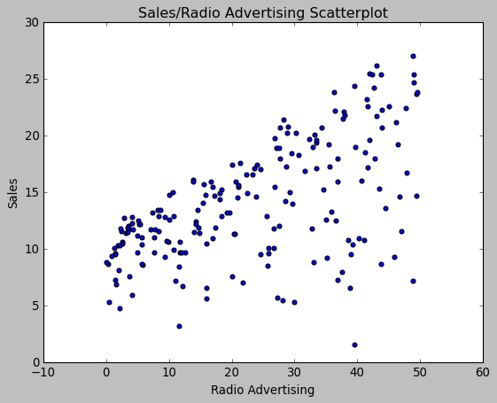
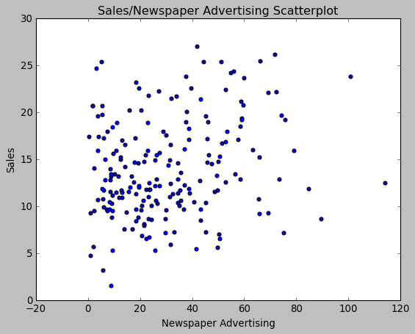
Advertising Data
We wish to predict Sales from TV, Radio, and Press by finding a function:
$$Sales ≈f(TV, Radio, Press)$$

Slide 5
Linear Regression
Model Specification and Assessment

Slide 6
Types of Regression Models
Regression models that involve one independent variable are called simple regressions
When two or more explanatory variables are involved, the relationships are called multiple regressions.
Regression models are also divided into linear and nonlinear models, depending on whether the relationship between the response and explanatory variables is linear or nonlinear.

Slide 7

Linear Regression
Overview
The linear regression model is a parametric model, meaning it assumes a mathematical form of the model function $f$
Specifically, it assumes that the model has the form:
$$Y=β_{0}+β_{1}X_{1}+β_{2}X_{2}+…+β_{p}X_{p}+ε, ε∼iid N(0, σ^{2})$$
Response variable
Model coefficients
Predictors
Error term (“Residual”)

Slide 8

Linear Regression
Model Assumptions
By assuming a form of a parametric model, we are making a number of assumptions about the data:
$$Y=β_{0}+β_{1}X_{1}+β_{2}X_{2}+…+β_{p}X_{p}+ε ε∼iid N(0, σ^{2})$$
Linearity: The response variable increases linearly with increases in the predictor variables
Residuals: The residuals are independent, normally distributed, with zero mean and a constant variance (homoskedasticity)

Slide 9
Estimating Regression Coefficients
The process of “fitting” or “training” a parametric model involves determining values of the model coefficients that minimize some “error function”
For basic linear regression models, that loss function is defined as the sum of the squares of the differences between actual and predicted values in the training data (“residuals sum of squares”)
Technique known as “Ordinary Least Squares”

Slide 10
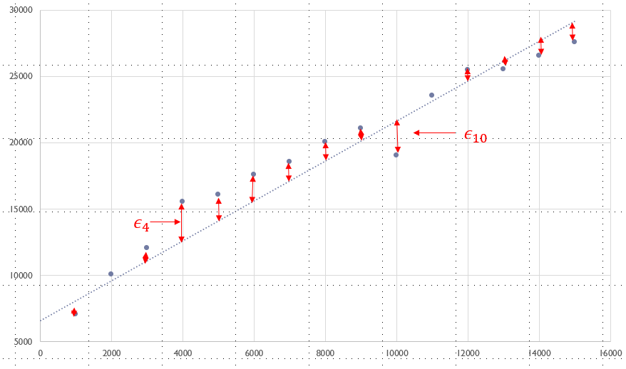

Estimating Regression Coefficients (SLR)
Residuals
Residuals are the difference from the regression line to the actual value of the data point (e.g., $ε_{4}$ and $ε_{10}$):
$$ε_{i}=y_{i}−{\hat{y}}_{i}=y_{i}−({\hat{β}}_{0}+{\hat{β}}_{1}x_{i})$$

Slide 11


Estimating Regression Coefficients (SLR)
Simple Linear Regression
Residuals Sum of Squares (RSS) is defined as the sum of the differences between the observations (data) and model (regression line):
$$RSS= \sum_{i=1}^{n}{{ε_{i}}^{2}=}\sum_{i=1}^{n}{{{(y}_{i}−{\hat{β}}_{0}−{\hat{β}}_{1}x_{i}\text{) }}^{2}}$$
The objective of the Ordinary Least Squares estimating technique is to find the values of $β_{0}$ and $β_{1}$that minimize the RSS value

Slide 12
Estimating Linear Regression Coefficients
Approaches
Many analytical models use optimization techniques to find optimal values for model coefficients
Doesn’t always guarantee to return a global optimum
In the case of linear regression models, it can be shown that optimization techniques will return a global optimum
In the case of linear regression models, the coefficients can also be directly calculated using calculus

Slide 13

Estimating Regression Coefficients
Simple Linear Regression
A little calculus determines that the values of ${\hat{β}}_{0}$ and ${\hat{β}}_{1}$ that minimize RSS are given by the formulas:
$${\hat{β}}_{1}=\frac{\sum_{i=1}^{n}{(x_{i}−\overline{x})(y_{i}−\overline{y})}}{\sum_{i=1}^{n}{{(x_{i}−\overline{x})}^{2}}}$$
$${\hat{β}}_{0}=\overline{y}−{\hat{β}}_{1}\overline{x}$$
where $\overline{y}≝\frac{1}{n}\sum_{i=1}^{n}{y_{i}}$ and $\overline{x}≝\frac{1}{n}\sum_{i=1}^{n}{x_{i}}$are the sample means

Slide 14

Multiple Linear Regression Coefficient Estimation
Two Predictors ($X_{1}, X_{2})$
Dependent variable (“outcome”)
Regression coefficients
Regression plane:
$$\hat{Y}=β_{0}+β_{1}X_{1}+β_{2}X_{2}$$
Independent variables (“predictors”)

Slide 15



Coefficient Estimation
Similar to simple linear regressions, the coefficients are estimating by minimizing the sum of squared residuals:
Solutions for the $p$ different coefficient estimations are expressed in complicated linear algebra form. They are computed by all of the standard statistical software packages.
Given the coefficient estimations, we can make predictions using the formula
$$RSS= \sum_{i=1}^{n}{{ε_{i}}^{2}=}\sum_{i=1}^{n}{{{(y}_{i}−{\hat{β}}_{0}−{\hat{β}}_{1}x_{i1}−{\hat{β}}_{2}x_{i2}−…−{\hat{β}}_{p}x_{ip}\text{) }}^{2}}$$
$\hat{y}={\hat{β}}_{0}+{\hat{β}}_{1}x_{1}$ + ${\hat{β}}_{2}x_{2}$ + $…$ + ${\hat{β}}_{p}x_{p}$

Slide 16
Linear Model Inference

Slide 17

Interpreting Linear Regression Coefficients
$${Y= β}_{0}+β_{1}X_{1}+β_{2}X_{2}+…+β_{p}X_{p}+ε$$
The ideal scenario is when predictors are uncorrelated
Each coefficient can be estimated and tested separately
Enables interpretations such as "a unit change in $X_{j}$ is associated with a $β_{j}$ change in $Y,$ while all the other variables fixed"
If predictor variables are appropriately scaled, it is easy to infer relative influence of predictors from their coefficients

Slide 18

Interpreting Linear Regression Coefficients
The Collinearity Problem
Correlations among predictors cause problems!
Claims of causality should be avoided for observational data
“A regression coefficient $β_{j}$ estimates the expected change in $Y$ per unit change in $X_{j}$ with all other predictors held fixed. But predictors usually change together!”
- “Data Analysis and Regression”, Mosteller and Tukey, 1977

Slide 19


Multicollinearity Problem
Simple Example
Suppose we fit a regression model with two predictors:
$$\hat{Y}=6X_{1}+12X_{2}$$
So far, so good, but what if $X_{1}$ and $X_{2}$ are perfectly correlated (say $X_{1}=4X_{2}$)?
Then, all of the following equations are correct (and many others!)
$$\hat{Y}=6X_{1}+12X_{2}$$
$$\hat{Y}=5X_{1}+16X_{2}$$
$$\hat{Y}=4X_{1}+20X_{2}$$
What can we intelligently say about the relationship between $X_{1}$ and Y??

Slide 20
Multicollinearity Problem
Examples Caused by Correlated Predictors
Estimating amount of change in your pocket $Y= β_{1}X_{1}+β_{2}X_{2}$
$X_{1}$ = # of pennies, nickels, dimes in your pocket (all coins except quarters)
$X_{2}=$Total number of coins in your pocket
By itself, $Y= β_{1}X_{1}$ would yield a positive value for $β_{1}$
What will happen to the value of $β_{1}$ if we add the $β_{2}X_{2}$ term to the model?

Slide 21
Multicollinearity Problem
Examples Caused by Correlated Predictors
Model for tackles by an American football player in a season (W is player’s weight, H is player’s height):
$$\hat{Y}=β_{0}+0.5W −0.1H$$
How do we interpret this ${\hat{β}}_{2}$ being less than 0?
Shorter players are better tacklers?

Slide 22
Multicollinearity Problem
Background
Unfortunately, not all collinearity problems can be detected by inspection of the correlation matrix
It is possible for collinearity to exist between three or more variables even if no pair of variables has a particularly high correlation
We call this situation multicollinearity
A better way to assess multi-collinearity is to compute the variance inflation factor (VIF)
We will discuss this further in the next module

Slide 23
Model Assessment

Slide 24
Model Assessment
Introduction
Note: for the discussion in the rest of this module, we will be using the same dataset for training and assessing the models
As noted in module 2, this is not a best practice
In the next module (4), we will be discussing different techniques to do a better model assessment and validation

Slide 25
Model Assessment
Primary Questions
How well does the model fit the data?
Is at least one of the predictors useful in predicting the response?
Do all of the predictors help to explain the response, or is it only a subset?
How well does the model perform prediction?

Slide 26

How Well Does the Model Fit The Data?
Two Type of Metrics
Regression models are generally assessed using two related metrics:
Absolute size of the modeling error (residual)
Sum of Squared Errors (SSE), Means Square Error (MSE) / Root Mean Squared Error (RMSE) / Average Squared Error (ASE)
Coefficient of Determination ($R^{2})$
A normalized factor that indicates the percentage of variance in the output variable that is explained by the regression model

Slide 27
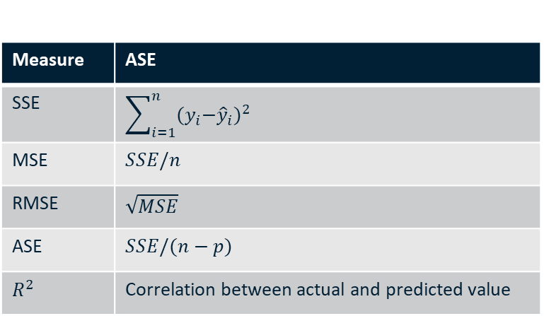
Common Regression Assessment Statistics
Measure | ASE
SSE | $$\sum_{i=1}^{n}{{{(y}_{i}−{\hat{y}}_{i})}^{2}}$$
MSE | $$SSE/n$$
RMSE | $$\sqrt{MSE}$$
ASE | $$SSE/(n−p)$$
$$R^{2}$$ | Correlation between actual and predicted value
Assessment statistics are dependent on the scale of the data and its inherent variance
“Normalized” assessment statistic

Slide 28

How Well Does the Model Fit The Data?
Calculating and Interpreting $R^{2}$
$R^{2}$ is the proportion of the variation in $Y$ that is explained by the model
$R^{2}$ generally lies between 0 and 1
0: No changes in Y explained by X
1: All changes in Y explained by X (perfect fit to the data)
$R^{2}$ is also called
Coefficient of determination
Coefficient of multiple determination
Multiple R-squared

Slide 29


How Well Does the Model Fit The Data?
Calculating and Interpreting $R^{2}$
$R^{2}$ is the proportion of the variation in $Y$ that is explained by the model
Amount of variability left after performing the regression
$$R^{2}=1 − \frac{Sum of Squared Erros (SSE)}{Total Sum of Squares \left(TSS\right)}=1 − \frac{{\sum_{i=1}^{n}{(y_{i}−{\hat{y}}_{i})}}^{2}}{{\sum_{i=1}^{n}{(y_{i}−\overline{y})}}^{2}}$$
Amount of variability inherent in response before regression is performed

Slide 30
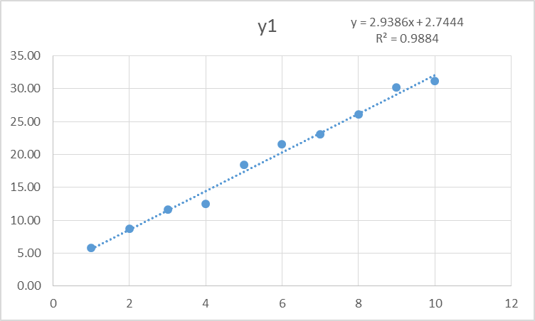
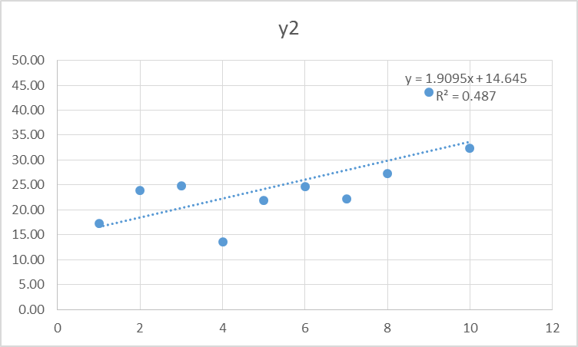
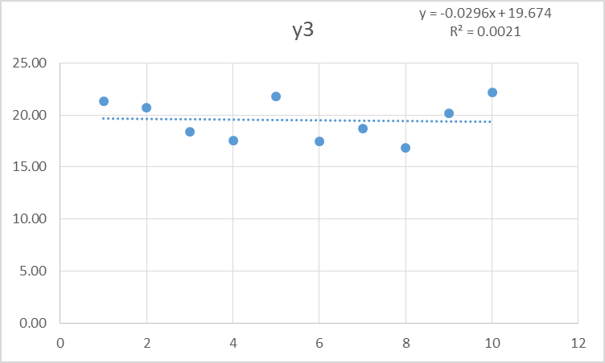
Calculating and Interpreting $R^{2}$

Slide 31
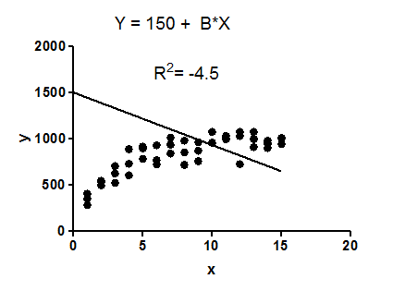

Calculating and Interpreting $R^{2}$
Notes
In the case of a simple (one predictor) linear regression $R^{2}$ is equal to the square of the correlation coefficient.
It is mathematically possible for an $R^{2}$ to be negative if the model is “worse than nothing” (that is, worse than a horizontal line for a simple linear regression)

Slide 32
Introduction to Scikit-Learn
Also Known as “Sklearn”

Slide 33
Scikit-Learn
Introduction
Power and robust open-source machine learning library for Python
Clean and uniform interface
Provides tools for many major data science tasks:
Regression
Classification
Clustering
Dimensionality reduction
Model selection
Preprocessing
User guide: https://scikit-learn.org/stable/user_guide.html

Slide 34
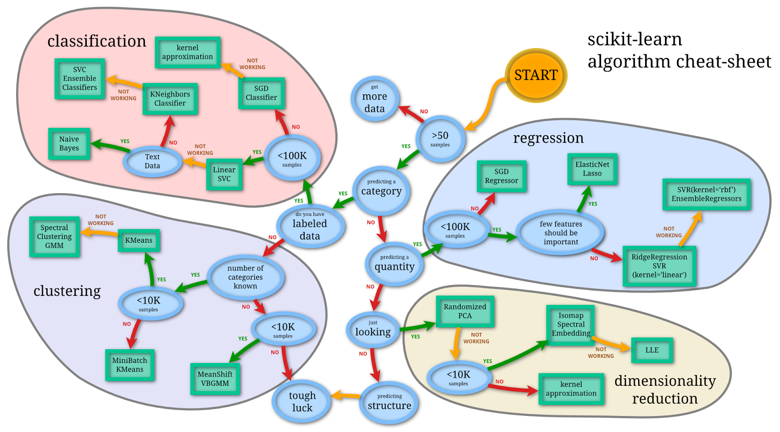
Scikit-Learn Algorithm Cheat-Sheet

Slide 35
Scikit-Learn Introduction
Data Layout
Scikit-Learn uses the standard tabular data structure discussed in Module 2
A given model dataset consists of two tables:
Feature matrix: two-dimensional numerical array or matrix. Generally implanted as NumPy arrays or Pandas dataframes. Generally labeled “X”.
Target array: one-dimensional array of the response variable. May be continuous (measures) or discrete (categories). Generally implemented as NumPy arrays of Pandas series. Generally labeled “y”

Slide 36
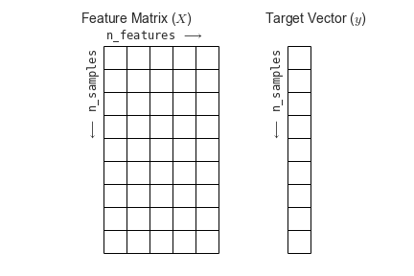
Scikit-Learn Introduction
Data Layout

Slide 37
Scikit-Learn Introduction
Basic Operations
Scikit-Learn is organized around three fundamental APIs:
Estimators. Model .fit() methods takes a feature matrix and a target vector and estimates the appropriate model
Predictors. Given a model that has been fit and a set of test data, the .predict() method and generates a prediction vector.
Transformers. Performs a variety of functions to modify data, including preprocessing, feature selection, feature extraction and dimensionality reduction algorithms.

Slide 38
Scikit-Learn Introduction
Basics of the API
Basic steps:
Choose a class (type) of model by importing the appropriate estimator class from Scikit-Learn
Choose model hyperparameters to create an instance of the selected model class
Arrange data into a features matrix and a target vector
Fit the model my calling the .fit() method of the model instance
Apply the model to predict new data using the predict() method

Slide 39
Scikit-Learn Introduction
Model Parameters and Hyperparameters
Parameters are part of a model and are estimated as part of the model training process (e.g., coefficients of regression models)
Hyperparameters are part of the model specification and are specified by the modeler/analyst (e.g., “K” in K-Nearest Neighbor models)

Slide 40
Scikit-Learn Introduction
Instances vs Classes
Classes are general types of models (e.g., Linear Regression)
Instances are specific configurations of model classes that can be used for model fitting and prediction

Slide 41
Scikit-Learn Introduction
Simple Linear Regression Example

Slide 42
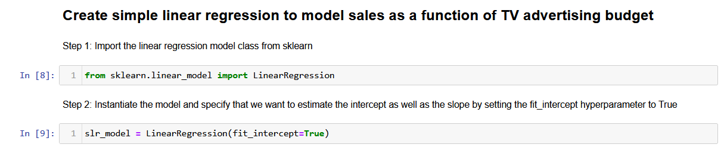
Scikit-Learn Introduction
Simple Linear Regression Example

Slide 43
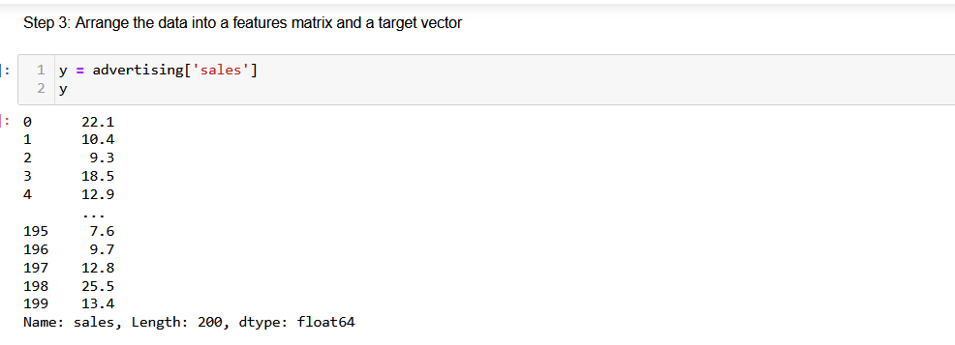
Scikit-Learn Introduction
Simple Linear Regression Example

Slide 44
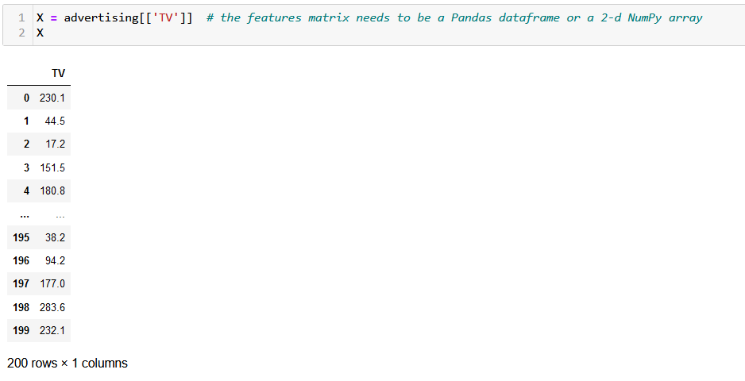
Scikit-Learn Introduction
Simple Linear Regression Example

Slide 45
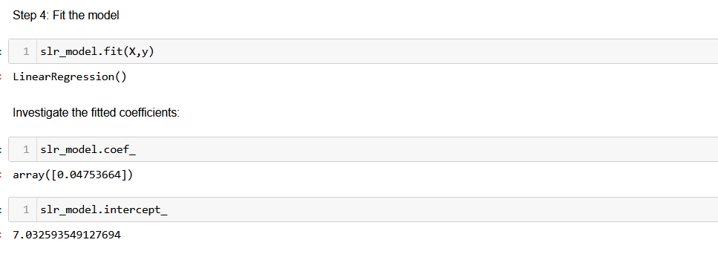
Scikit-Learn Introduction
Simple Linear Regression Example
Thus, our model is: $Sales=7.03+0.047∗TV$

Slide 46
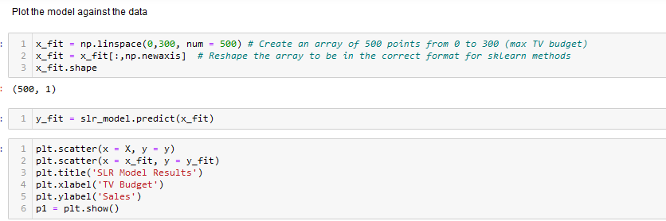
Scikit-Learn Introduction
Simple Linear Regression Example

Slide 47
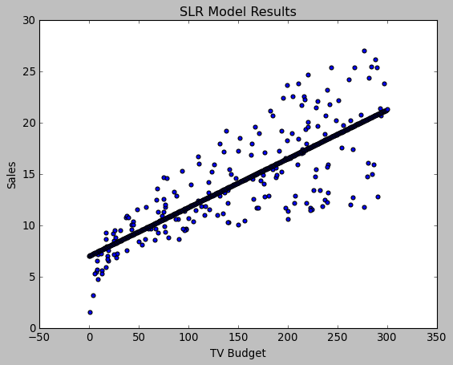
Scikit-Learn Introduction
Simple Linear Regression Example

Slide 48
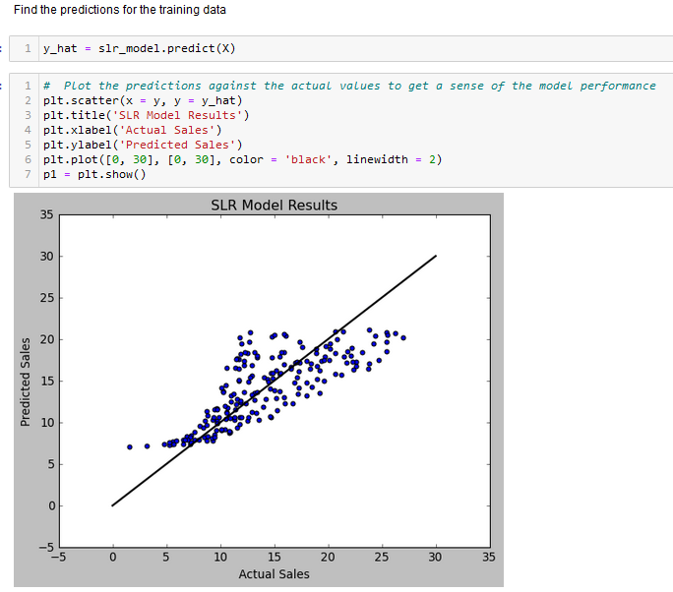
Scikit-Learn Introduction
Simple Linear Regression Example

Slide 49
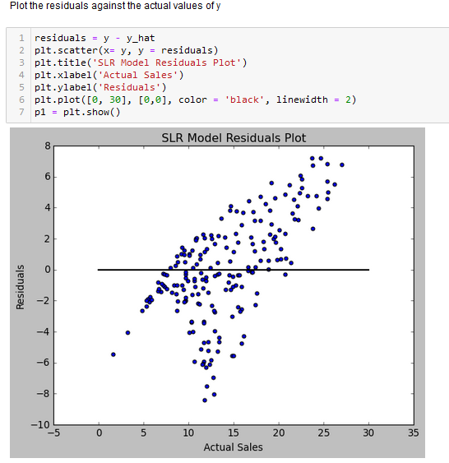
Scikit-Learn Introduction
Simple Linear Regression Example

Slide 50
Assessing the Accuracy of the Coefficient Estimates
ISLR 3.1.2

Slide 51
Coefficient Significance
Introduction
Performing a linear regression will always return a model, even if the predictors have NO influence on the response variable
We are interested in assessing the probability that predictors have no influence on the response. Specifically, we are interested in three different tests:
Is a specific coefficient equal to 0 (meaning that predictor has no influence)?
Are all the coefficients equal to 0?
Does a specific subset of coefficients have values of 0?

Slide 52
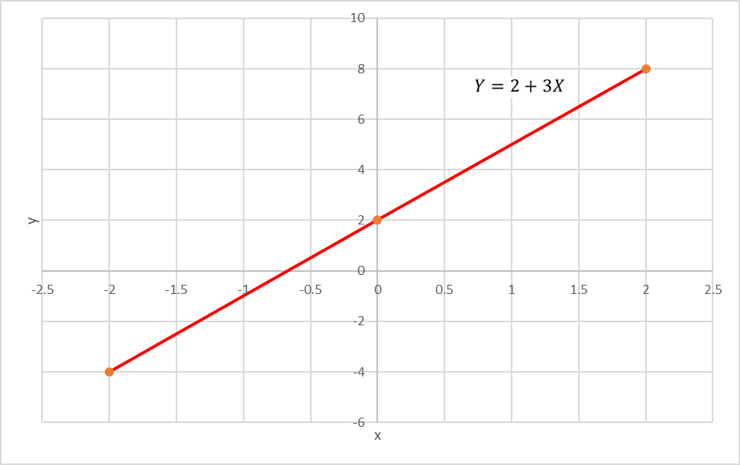

Coefficient Significance Analysis
Simple Linear Regression
Assume for the moment that somehow you know that the function that generated your data was: $Y=3X+2+ε ε∼iid N(0,1)$

Slide 53
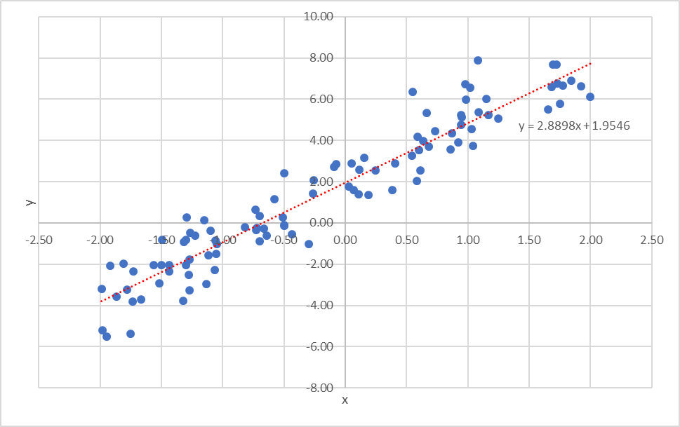
Coefficient Significance Analysis
Simple Linear Regression
Now, let’s generate 100 data points using the known generating function and then calculate the regression coefficients and plot the regression line:
Why is the regression line different from the true generating function?

Slide 54
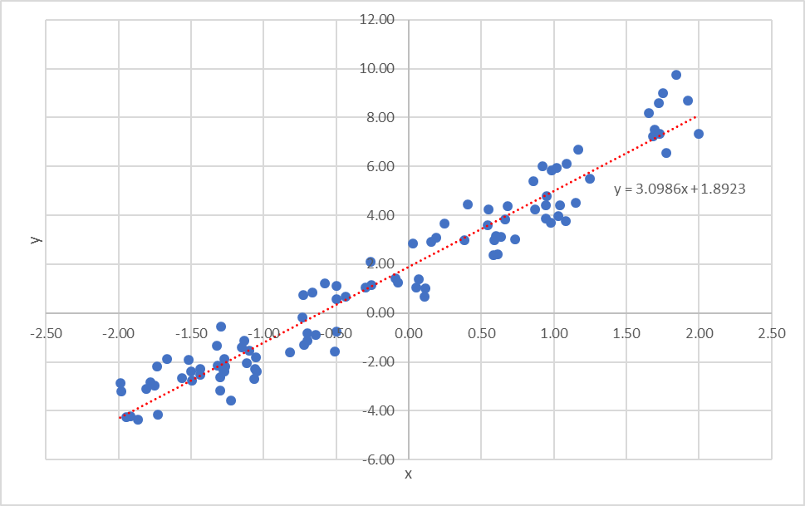
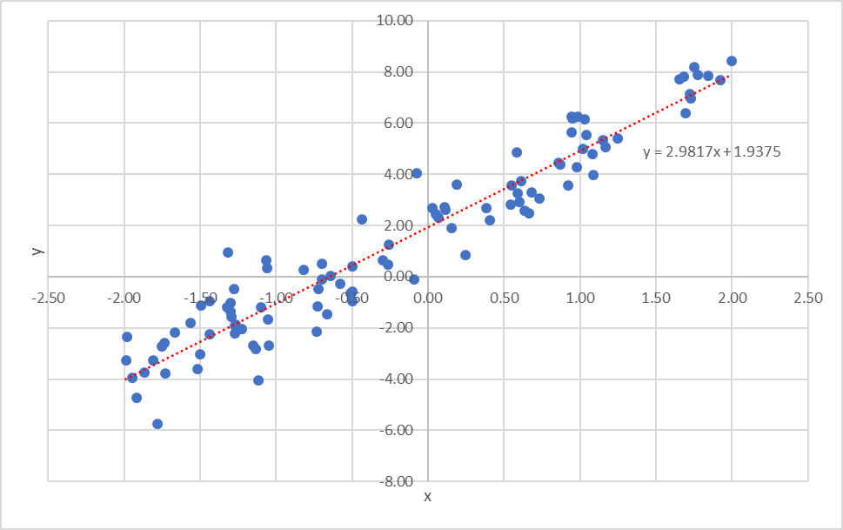
Coefficient Significance Analysis
Simple Linear Regression
Repeating the process a couple more times:

Slide 55
Coefficient Significance Analysis
Simple Linear Regression
The training data is a sample of the overall population
Our objective is to attempt to use the sample data to make an accurate model of the overall population
The coefficients are sample statistics: statistics calculated based on a sample that are estimates of the true population statistics
We are interested in knowing how much variance these sample statistics have
The term for the standard deviation of a sample statistic is standard error

Slide 56

Coefficient Significance Analysis
Simple Linear Regression
Same issue as you encounter when trying to estimate the average height of the students at a large university by randomly sampling 100 students and calculating the sample mean ($\hat{μ})$ to estimate the true population mean ($μ$).
Traditional sampling theory addresses this question by computing the standard error of $\hat{μ}$, written $SE(\hat{μ}$) and calculated by the formula:
$$SE\left(\hat{μ}\right)=σ/{\sqrt{n}}$$
Where $σ$ is the standard deviation of the underlying population and $n$ is number of samples taken

Slide 57

Coefficient Significance Analysis
Simple Linear Regression
Similarly, we are interested in how close our coefficient estimates ${\hat{β}}_{0}$ and ${\hat{β}}_{1}$ are to the actual values $β_{0}$ and $β_{1}$
The Standard Errors associated with ${\hat{β}}_{0}$ and ${\hat{β}}_{1}$ can be calculated by the following formulae:
$$SE{({\hat{β}}_{0})}^{2}= σ^{2}[\frac{1}{n}+\frac{{\overline{x}}^{2}}{\sum_{i=1}^{n}{{\left(x_{i}−\overline{x}\right)}^{2}}}]$$
$$SE{({\hat{β}}_{1})}^{2}=\frac{σ^{2}}{\sum_{i=1}^{n}{{(x_{i}−\overline{x})}^{2}}}$$
where $σ^{2}=Var(ε)$

Slide 58

Coefficient Significance Analysis
Considerations in Standard Error Calculations
Formula assumes that error terms $ε_{i}$are independent (uncorrelated) and all have the same variance $σ^{2}$
Generally, this is not true, but the formula gives reasonable results anyways
Generally, we don’t know $σ^{2}$! How could we unless we had all the underlying population data or knew the exact form of the generating function?
The approach is to estimate the population variance with the sample variance

Slide 59

Coefficient Significance Analysis
Simple Linear Regression
Once we know the standard error of the slope coefficient, determining if the coefficient is significant follows standard sampling theory:
Construct a confidence interval for the coefficient’s value with a given confidence interval. A 95% confidence interval is approximated by:
${\hat{β}}_{1} ±2∗SE({\hat{β}}_{1}$)
Determine if the confidence interval includes 0. If so, then we say that there is not a statistically significant probability that the corresponding predictor influences the response variable.

Slide 60

Coefficient Significance Analysis
Simple Linear Regression
Thinking about this in terms of hypothesis testing:
Null hypothesis $H_{0}:$ There is no relationship between $X_{1}$ and $Y$ ($β_{1}=0$)
Alternate hypothesis $H_{A}$: There is some relationship between X and Y ($β_{1}≠0$)

Slide 61

Coefficient Significance Analysis
Simple Linear Regression
Intuitively, we are asking whether the value of 𝛽_1 is sufficiently far from 0 that we have a reasonable confidence that it is indeed not zero. How far is “sufficiently far” depends on $SE({\hat{β}}_{1}$)
We do this by calculating the probability that the null hypothesis is true could have been observed due to random chance
If the probability is less than a pre-specified threshold (usually 5%), we “reject the null hypothesis” and conclude that that the alternate hypothesis is true

Slide 62
Coefficient Significance Analysis
Calculating P-Values of Coefficients
Unfortunately, the Scikit-Learn package does not provide statistical analysis (it is much more “machine learning” focused than “statistical learning”)
The “competing” Python package statsmodels contains fewer modeling algorithms and capabilities but it has more complete statistical results

Slide 63
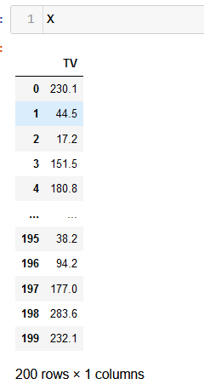
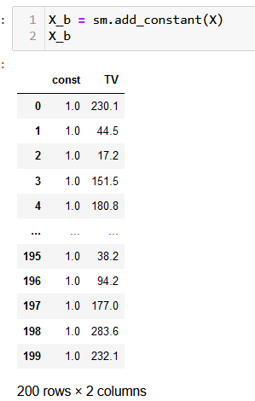
Coefficient Significance Analysis
Calculating P-Values of Coefficients
Unlike sklearn, statsmodels requires you to explicitly add a constant for the intercept to the predictor matrix

Slide 64
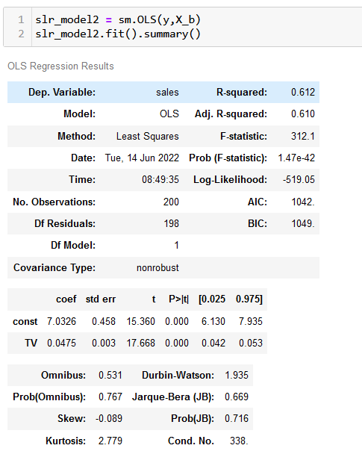
Coefficient Significance Analysis
Calculating P-Values of Coefficients
Coefficient of TV = 0.0475
Standard error of TV = 0.003
Approx 2/3 of observations fall between 0.0445 and 0.0505
Approx 95% of observations fall between 0.0415 and 0.0535
t-statistic is 17.668
Coefficient estimate is 17.6 standard errors from 0
P>|t| approx. 0.000
This is the “p-value”
There is a near 0 chance that this result (being non-zero) is due to random chance
95% CI is 0.042 – 0.053
This interval noes not include 0

Slide 65
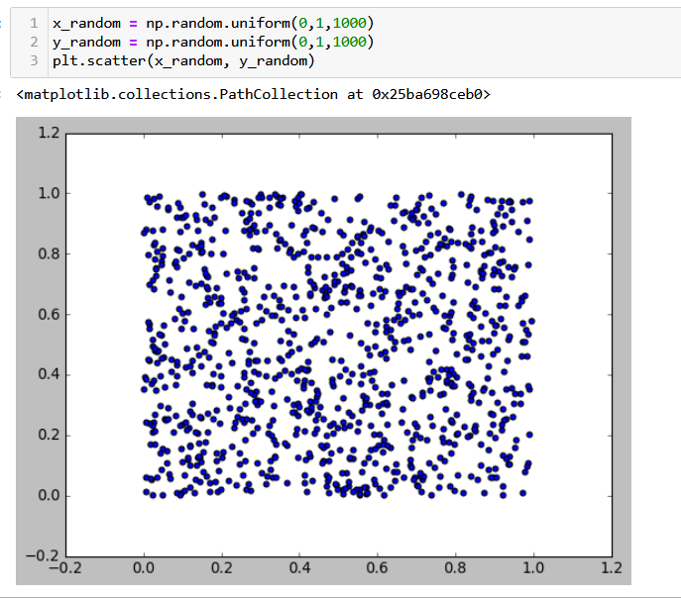
Coefficient Significance Analysis
Random Predictors and Responses

Slide 66
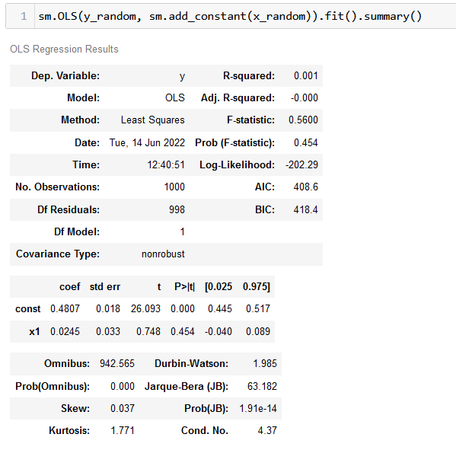
Coefficient Significance Analysis
Random Predictors and Responses

Slide 67
Assessing the Accuracy of the Model
ISLR 3.1.3

Slide 68
Assess Model Accuracy
Scikit-Learn Model Performance APIs
There are three different APIs for evaluating the quality of a model’s performance:
Estimator score method: Estimators have a score method providing a default evaluation criterion for the problem they are designed to solve.
Metric functions: The sklearn.metrics module implements functions assessing prediction error in a model-independent fashion.
Scoring parameter: Model-evaluation tools using an internal scoring strategy.

Slide 69
Assess Model Accuracy
Regression Metrics Methods
Regression methods include:
metrics.explained_variance_score
metrics.max_error
metrics.mean_absolute_error
metrics.mean_squared_error
metrics.r2_score
metrics.mean_absolute_percentage_error

Slide 70
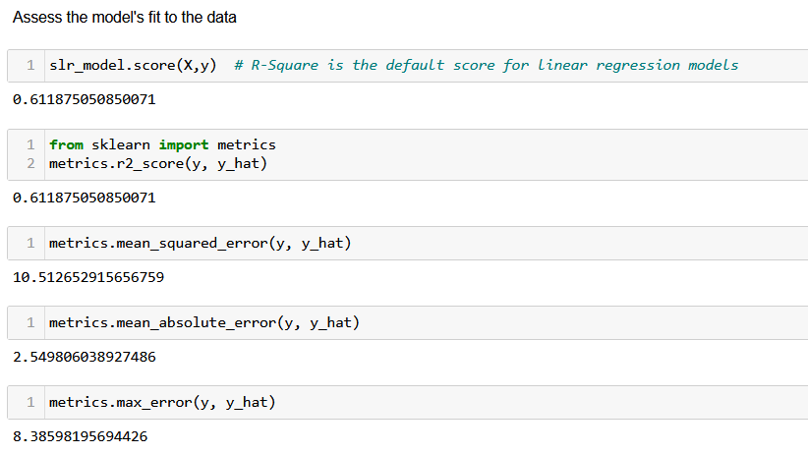
Assess Model Accuracy
SLR Model Examples

Slide 71

Assess Model Accuracy
Residual Standard Error
As discussed in the previous section, the training data should be considered as a sample from a larger population
Any estimate of a population value derived from a sample is referred to as a sample statistic
We previously analyzed the regression model coefficients (e.g., ${\hat{β}}_{1}$) as a sample statistic of a population parameter ($β_{1}$)
The standard deviation of any sample statistic is referred to as its standard error

Slide 72


Assess Model Accuracy
Residual Standard Error (RSE)
Another sample statistic we are very interested in is the standard error of the residual term $ε$
Even if we knew $β_{0}$ and $β_{1}$ perfectly, we would not be able to perfectly predict $Y$ from $X$
$$RSE= \sqrt{\frac{1}{n−2}RSS}= \sqrt{\frac{1}{n−2}\sum_{i=1}^{n}{{(y_{i}−{\hat{y}}_{i})}^{2}}}$$
Degrees of freedom $n−1−p$

Slide 73
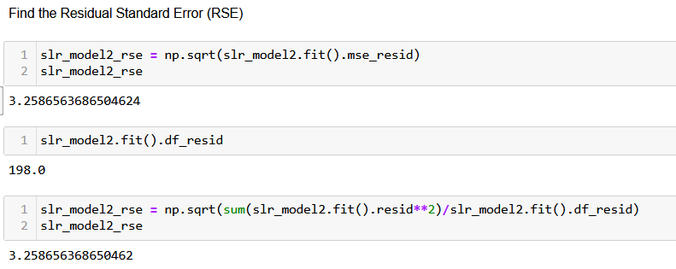
Assess Model Accuracy
Residual Standard Error
Curiously, neither scikit-learn nor statsmodels provides RSE as a standard output (most other statistics packages do)

Slide 74
Assess Model Accuracy
Residual Standard Error Interpretation
RSE can be interpreted as the lack of fit of the model
The lower the better
It can roughly be interpreted as the average amount that the prediction will deviate from the true regression line
In this example, even if the regression model was exactly correct, any prediction of sales based on TV advertising would be off by approximately 3,260 units on average

Slide 75
Multiple Linear Regression Models

Slide 76
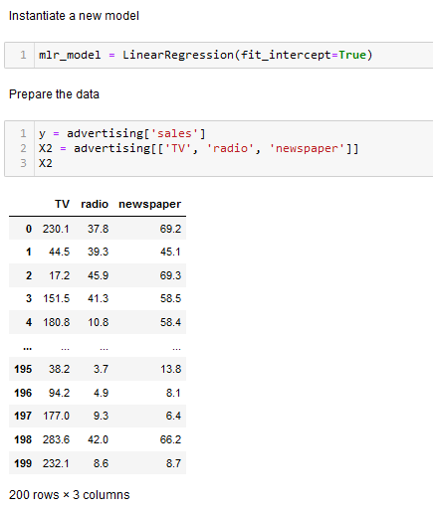
Multiple Linear Regression Example
Create Model and Prepare Data

Slide 77
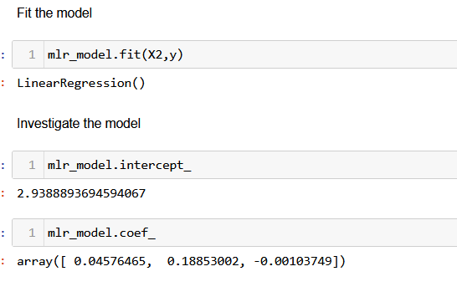
Multiple Linear Regression Example
Fit and Investigate the Model
$$Sales=2.94+0.045∗TV+0.19∗radio −0.001∗newspaper$$

Slide 78
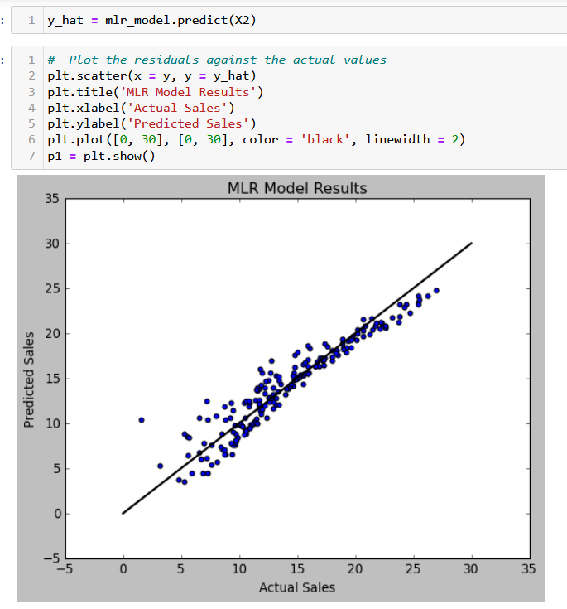
Multiple Linear Regression Example
Assess Model Fit

Slide 79
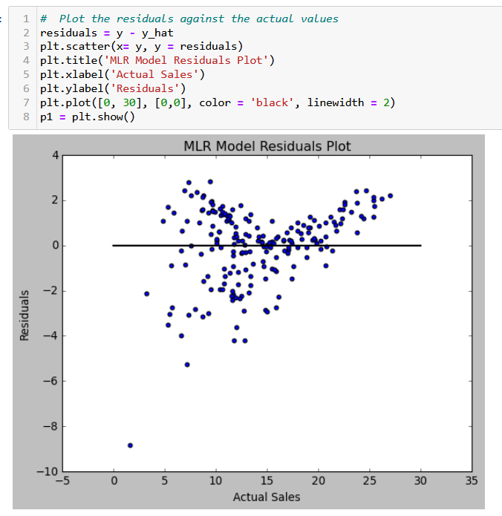
Multiple Linear Regression Example
Assess Model Fit
What violation of the linear model assumptions do you see here?

Slide 80
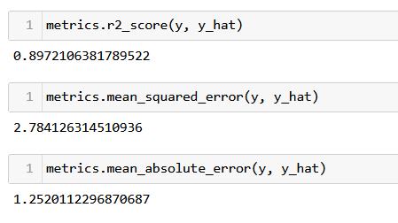
Multiple Linear Regression Example
Assess Model Fit

Slide 81
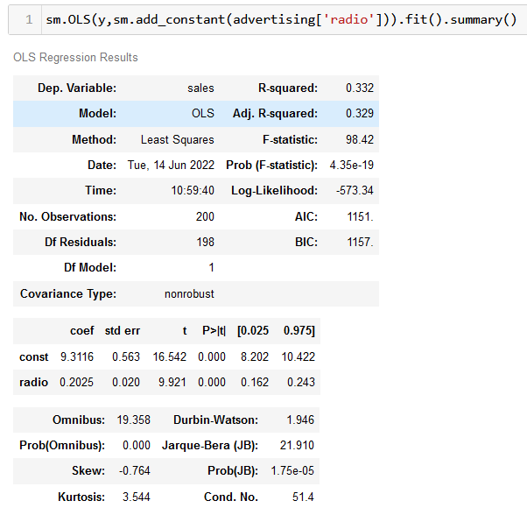
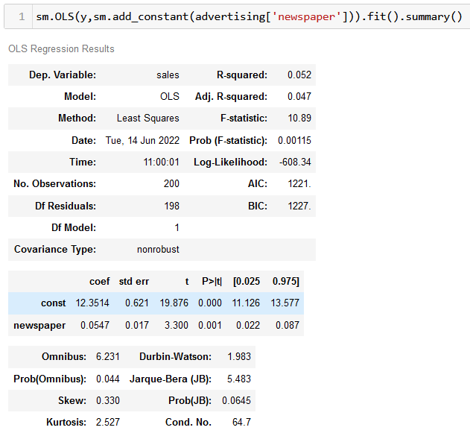
MLR Coefficient Significance Analysis
Looking at Possible SLR Models

Slide 82
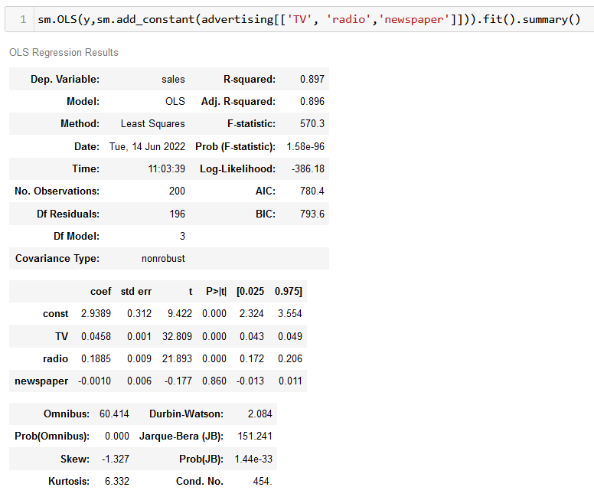
Coefficient Significance Analysis
Looking at the MLR Model
Why does the MLR model show no significant relationship between newspaper budget and sales while the SLR model does?

Slide 83
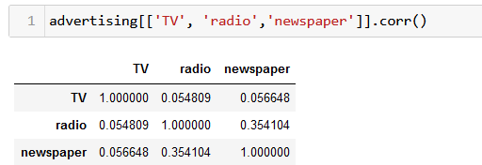
Coefficient Significance Analysis
Interpreting MLR Coefficients
This is an example of confusion that can be caused by correlated predictors:
Markets where the company has higher newpaper advertising budgets tend to also have higher radio advertising

Slide 84
Coefficient Significance Analysis
Interpreting MLR Coefficients
This model is implying that that newspaper advertising is not associated with sales, but radio advertising is
However, in markets where we are spending more on radio advertising, we are also spending more on newspaper advertising
Newspaper advertising is a “surrogate” for radio advertising

Slide 85
Assessing the Accuracy of the Model
ISLR 3.2.2

Slide 86

MLR Model Assessment
Basic Questions
Is at least one of the predictors useful in predicting the response?
Stating in terms of hypothesis testing, we want to test the null hypothesis:
$H_{0}:$ $β_{1}=β_{2}= …=β_{p}=0$
Against the alternative hypothesis:
$H_{a}:$ at least one $β_{j}$ is non-zero

Slide 87

MLR Model Assessment
Basic Questions
Is at least one of the predictors useful in predicting the response?
Stating in terms of hypothesis testing, we want to test the null hypothesis:
$H_{0}:$ $β_{1}=β_{2}= …=β_{p}=0$
Why not just calculate the individual p-values for each variable?

Slide 88

MLR Model Assessment
Is at least one of the predictors useful in predicting the response?
We accept or reject the null hypothesis by computing the F-statistic:
$$F= \frac{(TSS−RSS)/p}{RSS/(n−p−1)} ∼F_{p,n−p−1}$$
where, as with the Simple Regression,
TSS = ${\sum_{i=1}^{n}{(y_{i}−\overline{y})}}^{2}$ and RSS = ${\sum_{i=1}^{n}{(y_{i}−{\hat{y}}_{i})}}^{2}$

Slide 89

MLR Model Assessment
Is at least one of the predictors useful in predicting the response?
If there is no relationship between the response and the predictors, the F-statistic will be close to 1. If $H_{a}$ is true, then the F-statistic will be greater than 1. How much larger it needs to be depends on the values of n and p
Most statistical software packages (including statsmodels) compute the p-value associated with the F-statistic which can be used to determine whether to reject $H_{0}$

Slide 90
MLR Model Assessment
Is at least one of the predictors useful in predicting the response?
P-value of F-statistic much less than 0.05
At least one predictor is significant

Slide 91
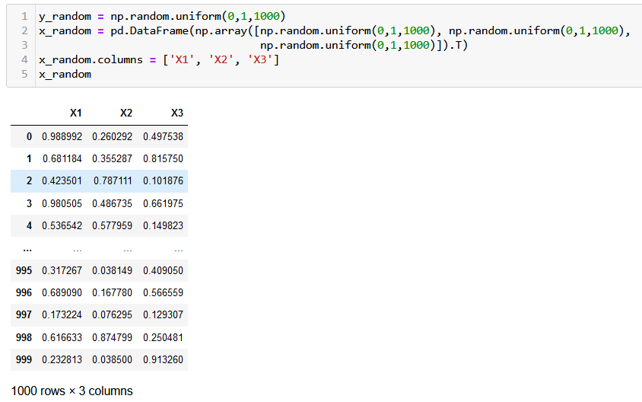
Coefficient Significance Analysis
Random Predictors and Responses

Slide 92
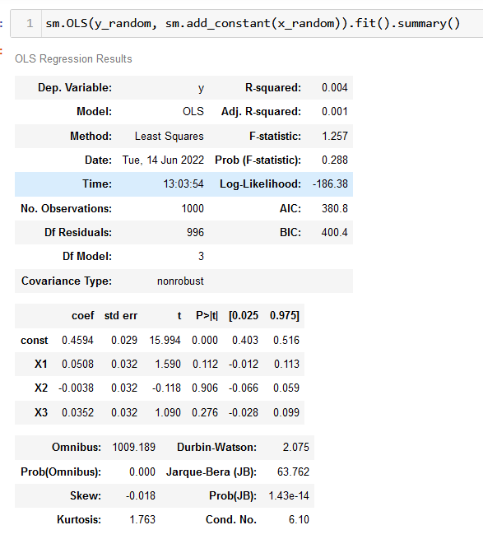
Coefficient Significance Analysis
Random Predictors and Responses

Slide 93

Assessment Techniques Summary
Simple Linear Regression
How accurate and significant are the coefficients?
t-statistics and p-values of coefficients
How well does the model fit the data?
Mean Square Error (and related statistics)
$R^{2}$
Residual Standard Error

Slide 94

Assessment Techniques Summary
Multiple Linear Regression
Do the predictors collectively have a significant effect on the response?
F-statistic
How accurate and significant are the coefficients?
t-statistics and p-values of coefficients
How well does the model fit the data?
Mean Square Error (and related statistics)
$R^{2}$
Residual Standard Error

Slide 95
Model Extensions

Slide 96
Model Extensions
Overview
Next, we will consider some extensions required to handle more “real world” datasets:
Incorporating categorical predictors
Dealing with nonlinearities in the relationship between predictor and response variables
Dealing with “interaction effects” – situations where the influence one predictor has on the response is partially modified by the value of a second predictor

Slide 97
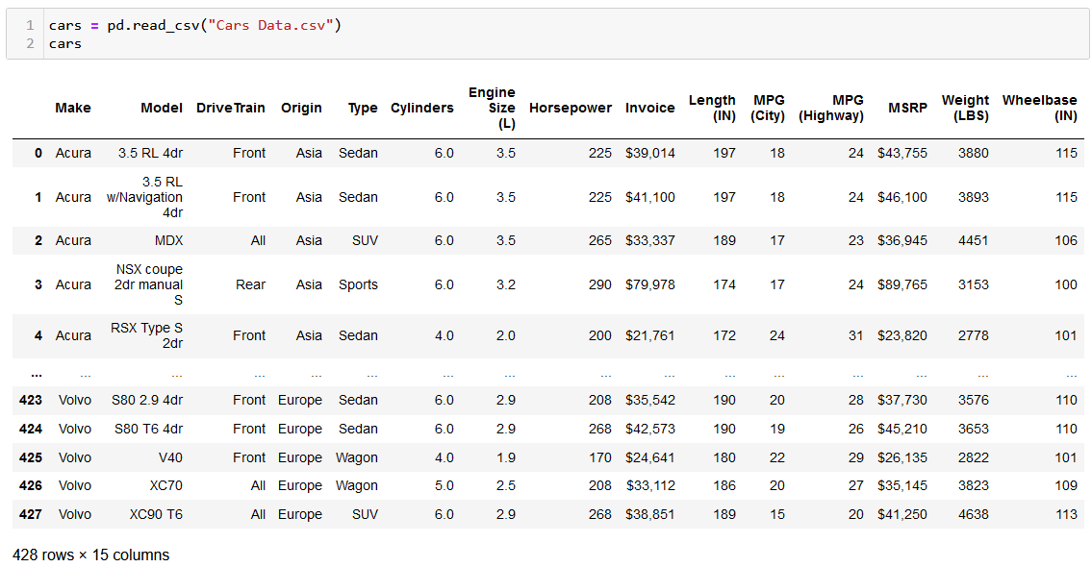
Model Exensions
Objective: predict fuel efficiency of a car (as represented by MPG – Highway)
Cars Dataset

Slide 98
Initial Model
Basic modeling methodology is to first drop variables that are clearly:
Irrelevant
Redundant (highly correlated)
Since our objective is to model a car’s MPG based on its physical (or designed) attributes, we drop the following variables as being clearly irrelevant:
Make
Model
Origin
Price (MSRP) / Invoice
MPG City (dropped because it is another version of the response variable)

Slide 99
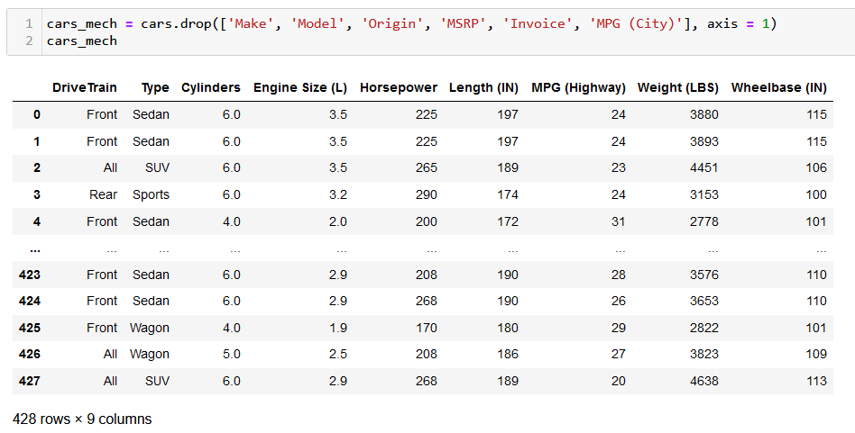
Initial Model
Dropping Irrelevant Variables

Slide 100
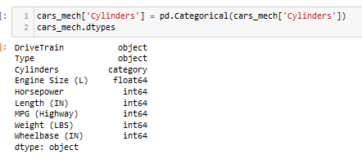
Initial Model
Convert Cylinders to be a Category

Slide 101
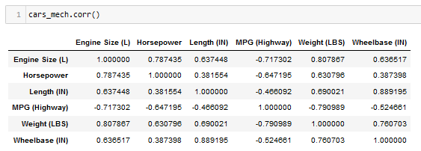
Initial Model
Looking at Correlations

Slide 102
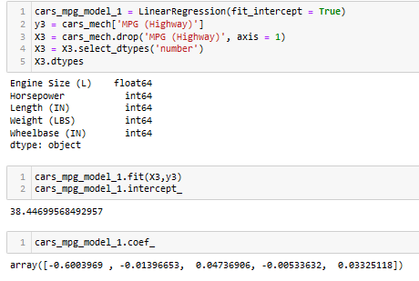
Initial Model
Model Specification and Fitting
$$MPG=38.4 −0.6∗EngineSize −0.1∗Horsepower+0.05∗Length−0.01∗Weight+0.03∗Wheelbase$$

Slide 103
Initial Model
Observations
$$MPG=30.4 −0.6∗EngineSize −0.1∗Horsepower+0.05∗Length−0.01∗Weight+0.03∗Wheelbase$$
Clearly, we have a model with several highly correlated variables
EngineSize and Horsepower are strongly correlated and represent engine power
Length, Weight, and WheelBase are strongly correlated and represent car size
We will return to the topic of refining this model to improve both performance and interpretability in module 4

Slide 104
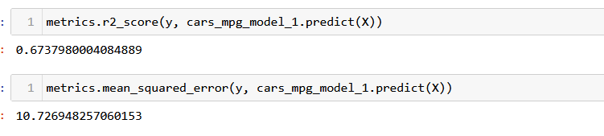
Initial Model
Model Assessment

Slide 105
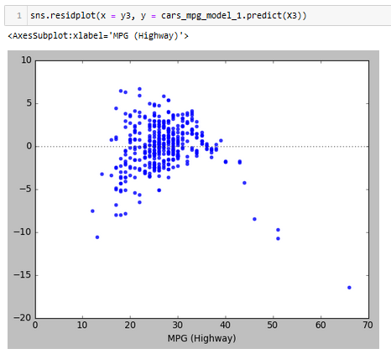
Initial Model
Residuals Plot

Slide 106
Incorporating Categorical Predictors

Slide 107
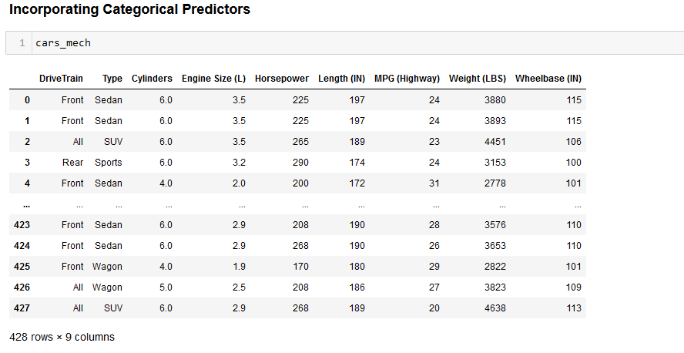
Cars Dataset
How do we add “DriveTrain” to our model?

Slide 108


Incorporating Categorical Predictors
Binary Categories
Sometimes we wish to include categorical attributes as independent variables in a regression
Example: investigating differences in height between men and women
We create a new variable:
With a resulting model:
$$x_{i}=\left\{\begin{matrix}1 if i^{th} person is female \\ 0 if i^{th} person is male\end{matrix}\right.$$
$$y_{i}= \left\{\begin{matrix}β_{0}+β_{1}+ε_{i} if i^{th} person is female \\ β_{0}+ε_{i} if i^{th} person is male\end{matrix}\right.$$

Slide 109

Adding Categorical Predictors
If a categorical predictor has more than two levels, we create one fewer dummy variables than the number of levels. For example, for the Origin categorical attribute (which has three possible values) in the cars data, we would create two dummy variables:
$$x_{i1}=\left\{\begin{matrix}1 if i^{th} observation has Drivetrain \text{"}Front" \\ 0 if i^{th} observation does not have Drivetrain "Front"\end{matrix}\right. \\ x_{i2}=\left\{\begin{matrix}1 if i^{th} observation has Drivetrain \text{"}All" \\ 0 if i^{th} observation does not have Drivetrain "All"\end{matrix}\right.$$

Slide 110

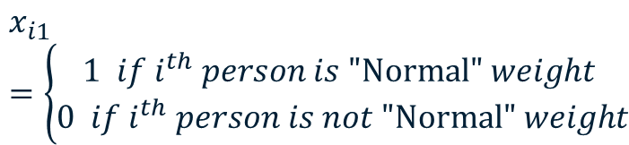
Adding Categorical Predictors
If a categorical predictor has more than two levels, we create one fewer dummy variables than the number of levels. For example, for the Origin categorical attribute (which has three possible values) in the cars data, we would create two dummy variables:
With a resulting model:
$$x_{i1}=\left\{\begin{matrix}1 if i^{th} person is \text{"}\text{Normal}\text{"} weight \\ 0 if i^{th} person is not \text{"}\text{Normal}\text{"} weight\end{matrix}\right.$$
$$y_{i}= \left\{\begin{matrix}β_{0}+β_{1}+ε_{i} if i^{th} observation has drivetrain "Front" \\ β_{0}+β_{2}+ε_{i} if i^{th} observation has drivetrain "All" \\ β_{0}+ε_{i} if i^{th} observation has drivetrain "Rear"\end{matrix}\right.$$
“Baseline”

Slide 111

Incorporating Categorical Predictors
Add DriveTrain Dummy Variables

Slide 112

Incorporating Categorical Predictors
Add Type Dummy Variables

Slide 113

Incorporating Categorical Predictors
Add Cyllinders Dummy Variables

Slide 114

Incorporating Categorical Predictors
Extended Model Predictors

Slide 115

Incorporating Categorical Predictors
Extended Model Specification

Slide 116

Incorporating Categorical Predictors
Model Fit

Slide 117

Incorporating Categorical Predictors
Model Assessment

Slide 118

Incorporating Categorical Predictors
Residuals Plot

Slide 119
Adding Nonlinear Variables

Slide 120
Linear Regression Reminder
Model Assumptions
By assuming a form of a parametric model, we are making a number of assumptions about the data:
$$Y=β_{0}+β_{1}X_{1}+β_{2}X_{2}+…+β_{p}X_{p}+ε ε∼iid N(0, σ^{2})$$
Linearity: The response variable increases linearly with increases in the predictor variables
Residuals: The residuals are independent, normally distributed, with zero mean and a constant variance (homoskedasticity)

Slide 121
Adding Nonlinear Variables
Model Diagnosis
Model diagnosis largely involves looking for and correcting aspects of the data that are inconsistent with the model assumptions
We will look at model diagnosis in more detail in module 4, but for now we want to investigate the linearity assumption
We can do this by plotting scatterplots of individual predictors to the response variable

Slide 122



Adding Nonlinear Variables
Model Diagnosis
Let’s investigate using the square of horsepower in our model

Slide 123

Adding Nonlinear Variables
Polynomial Regression
Simple to extend linear model to accommodate non-linear relationships using polynomial regression:
$$Y=β_{0}+β_{1}X_{1}+β_{2}{X_{1}}^{2}+β_{3}{X_{1}}^{3}+ …+ε$$
This is still a linear model, and we can use all of the linear regression techniques by simply creating calculated attributes ${X_{1}}^{2}$ and ${X_{1}}^{3}$

Slide 124

Adding Nonlinear Variables
Adding a Square of Horsepower to Model

Slide 125

Adding Nonlinear Variables
Fitting Model

Slide 126

Adding Nonlinear Variables
Model Assessment

Slide 127

Adding Nonlinear Variables
Assessing Residuals

Slide 128
Adding Interaction Effects

Slide 129

Adding Interaction Effects
Background
The basic linear model assumes that the coefficients are constant and independent of the levels of the other predictors:
$$Y=β_{0}+β_{1}X_{1}+β_{2}X_{2}+…+β_{p}X_{p}+ε$$
However, sometimes a coefficient value is different based on the levels of other predictors

Slide 130
Adding Interaction Effects
Examples
Advertising example: suppose that spending on radio advertising increases the effectiveness of TV advertising
Known as “synergy effect” in marketing
In this case, we would want the coefficient on the TV predictor to be higher if the level or the radio predictor is higher

Slide 131
Adding Interaction Effects
Examples
Factory productivity:
Suppose we wish to model the factory output as a function of the number of workers and the number of assembly lines
Now, suppose we wish to predict the increase in the number of units produced caused by the addition of an assembly line
Clearly, the increased output from an additional assembly line will depend on the number of workers available

Slide 132


Adding Interaction Effects
Examples
Drug effectiveness example: modeling of a drug to treat anxiety. Researchers hypothesize an interaction effect based on gender
No apparent interaction effect based on gender. For both males and females, 1 mg of drug lowers anxiety level by 0.2 units
Interaction effect based on gender is suggested. Drug reduces anxiety more effectively for women than for men.

Slide 133

Adding Interaction Effects
Interaction Terms
In the standard multiple linear regression model, it is assumed that the effect on the output is independent of the levels of the other inputs:
$$Y=β_{0}+β_{1}X_{1}+β_{2}X_{2}+ε$$
Interaction terms incorporate interactions between two independent variables in the form:
$$Y=β_{0}+β_{1}X_{1}+β_{2}X_{2}+β_{3}{X_{1}X}_{2}+ε$$
Interaction Term

Slide 134


Adding Interaction Effects
Interaction Terms
The model with an interaction term:
$$Y=β_{0}+β_{1}X_{1}+β_{2}X_{2}+β_{3}{X_{1}X}_{2}+ε$$
Can be rewritten as:
$$Y=β_{0}+\left(β_{1}+β_{3}X_{2}\right)X_{1}+β_{2}X_{2}+ε \\ =β_{0}+\tilde{β_{1}}X_{1}+β_{2}X_{2}+ε$$
where $\tilde{β_{1}}=\left(β_{1}+β_{3}X_{2}\right)$
Coefficient of $X_{1}$ depends on level of $X_{2}$

Slide 135

Adding Interaction Effects
Advertising Example
Testing hypothesis that there is a synergy effect between radio and TV advertising:

Slide 136


Adding Interaction Effects
Advertising Example
Model $R^{2}$ is significantly larger than a model that only includes radio and tv ($R^{2}=0.$897)
Small p-value on interaction term indicates that it is significant

Slide 137
Modeling Interactions
Notes
With measure/measure predictor pairs, generally an interaction effect should be hypothesized based on knowledge of the data and the underlying system it represents
Create a model and observe the significance (p-value) of the coefficient of interaction term
With category/measure predictor pairs, interaction effects can be observed by looking at scatter plots
Different slopes for the different categories indicates a possible interaction

Slide 138

Adding Interaction Effects
Interactions with Categorical Predictors
Interactions can also occur involving a measure and a category
Consider this dataset regarding credit card balances:

Slide 139

Adding Interaction Effects
Credit Dataset – Model 1
We wish to predict the size of the credit card balance based on income and student status:

Slide 140

Adding Interaction Effects
Modeling With Categorical Variables
Our model would become:
$$balance= β_{0}+ β_{1}∗income+ β_{2}∗student \\ =β_{1}∗income+ \left\{\begin{matrix}β_{0}+β_{2} if student \\ β_{0} if not student\end{matrix}\right.$$
Two parallel lines (same slope, different intercept)

Slide 141

Adding Interaction Effects
Credit Dataset – Model 1
Fit the model:

Slide 142


Adding Interaction Effects
Credit Dataset – Model 1

Slide 143

Adding Interaction Effects
Investigating Interaction Effect

Slide 144

Adding Interaction Effects
Investigating Interaction Effect

Slide 145

Adding Interaction Effects
Investigating Interaction Effect

Slide 146
Modeling Interactions
Notes
It is not a good practice to test every pair of attributes in this way
Why? (hint: “p-hacking” or the multiple hypothesis test problem)
If you decide to include an interaction effect, you should also include both individual predictors in the interaction, even if their p-value indicates non-significance
Know as the “hierarchical principle”

